Slide 1

Mine Owners, Manufacturers & Exporters of Minerals
ESTD… 2000

Slide 2
Company Profile Incorporated in 2000 by Mr Kishore Chandni, Sunrise Exports is one of the leading Mine Owners, Manufacturers, Exporters & Suppliers of mining products like Talc Powder / Soapstone Powder, Dolomite Powder, Calcite Powder, China Clay Powder, Quartz Silica Powder. These mining products are supplied in different parts of the world. With a strong focus on quality and development we are geared to meet the challenges of the 21st century and to maintain our leadership in the market.

Slide 3
QUALITY
Committed to quality as all our products are subjected to stringent ISO STD TESTS.
Products tested on various parameters.
Quality achieved by number of inspection procedures performed by professional production technicians.
Finest raw materials used in production. Products are met to quality standards before reaching the market.
Regular quality checks conducted to maintain quality standards of the final product that reaches the market.
Dedicated to provide our customers with the finest quality products and services, assuring timely of orders.

Slide 4
Factors which have helped us in creating niche in a short span of time
Quality goods
Timely delivery
Customer satisfaction
Easy mode of payment
Professional team of workers
Large clientele base

Slide 5
OUR CLIENTELE
West Africa
South Africa
Central Africa
Middle East Countries

Slide 6
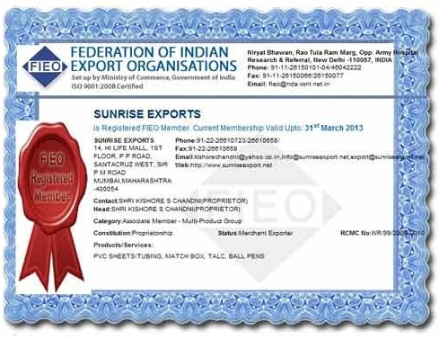
Memberships We are registered members of the Federation of Indian Export Organization, Govt of India.

Slide 7
COMPANY USP
Installation Training
Onsite Support
Operational Training
User Manual
Experienced R & D Department
Large Production Capacity
Large Product Line
Best Testing Facilities

Slide 8
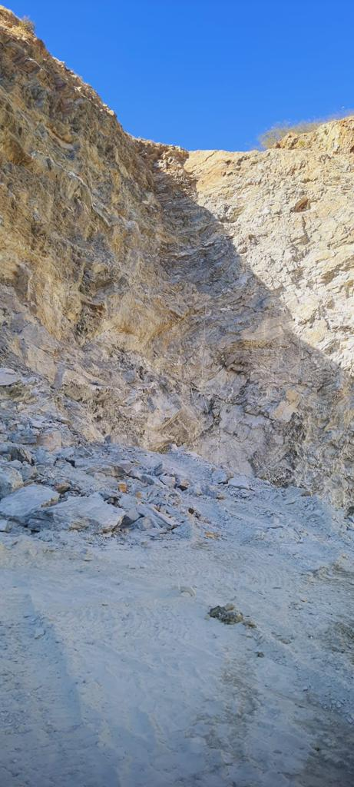
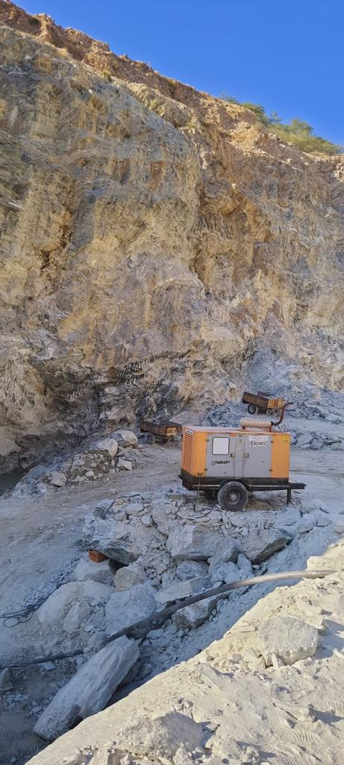
OUR MINING SITE

Slide 9
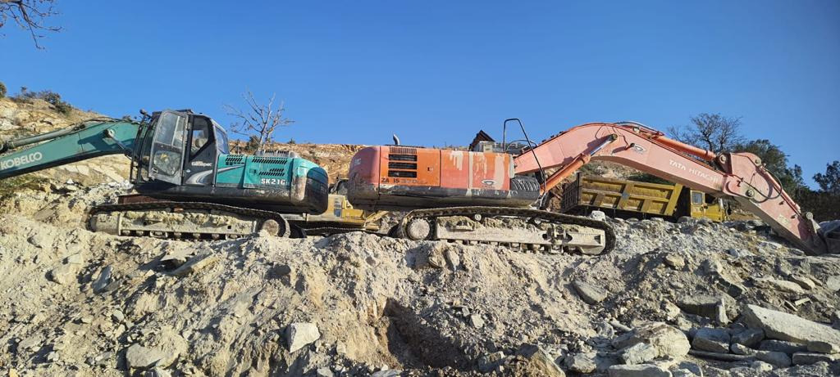
OUR MINING SITE

Slide 10
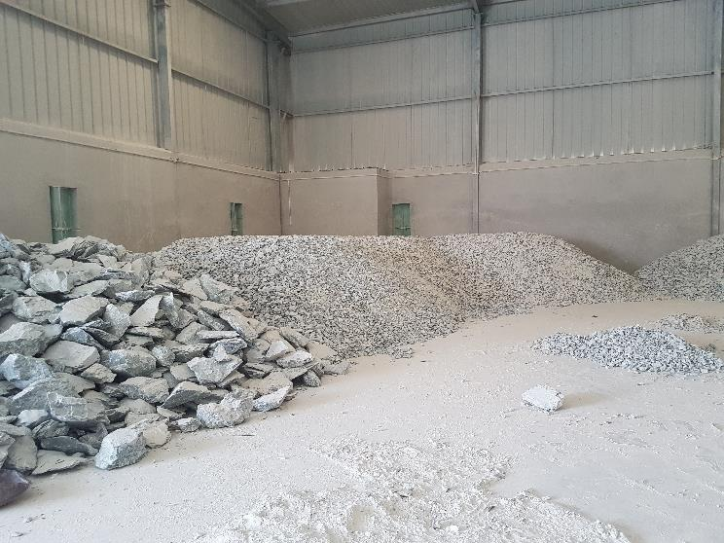
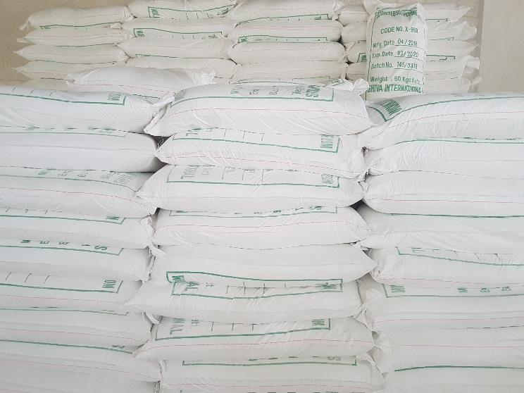
OUR FACTORY SITE

Slide 11
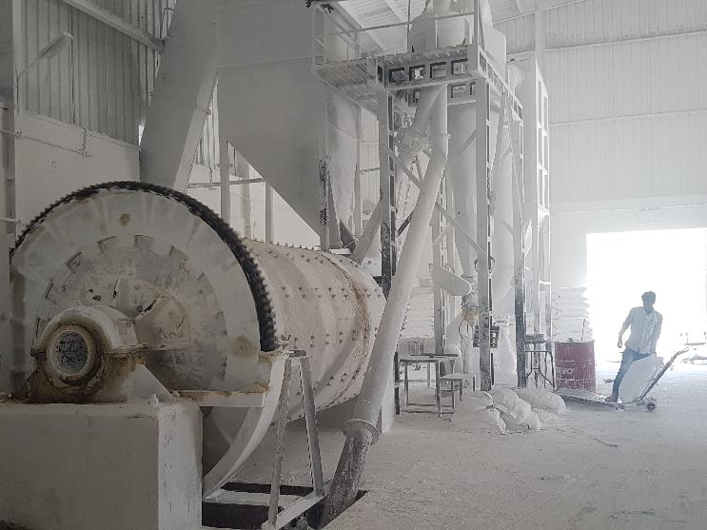
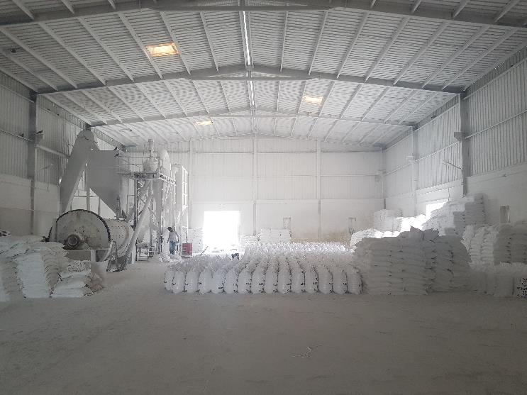
OUR FACTORY SITE

Slide 12
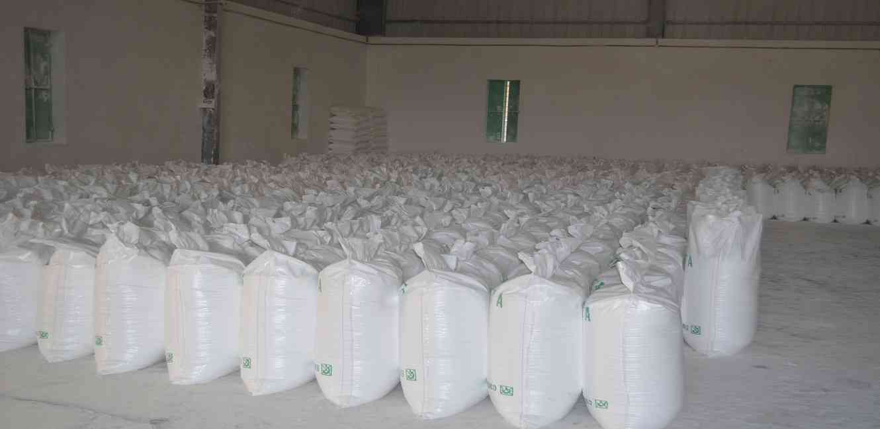
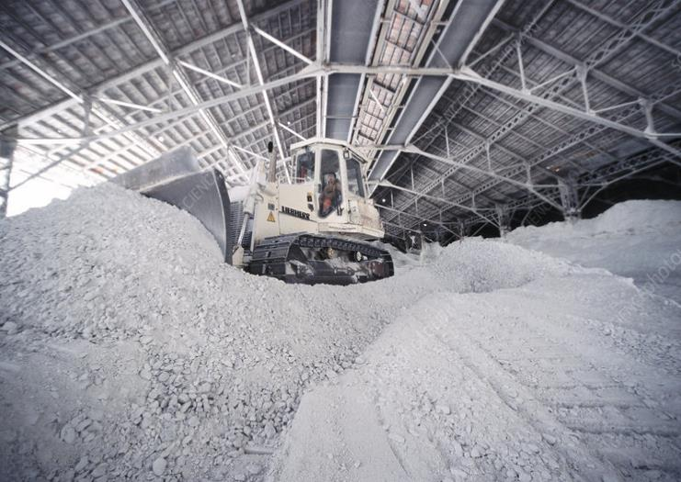
OUR FACTORY SITE

Slide 13
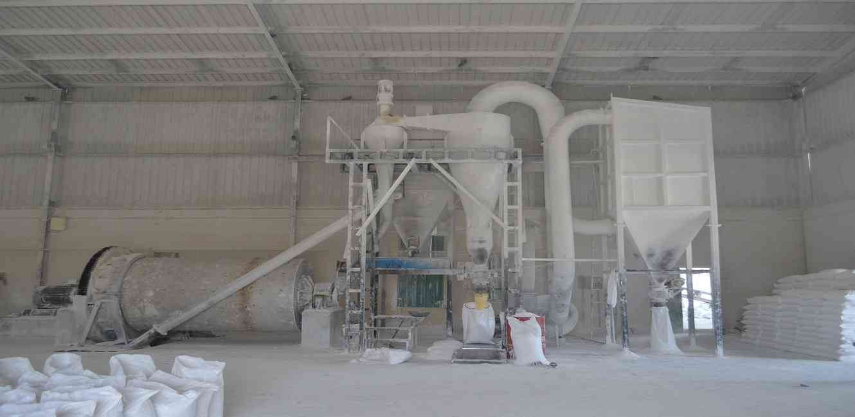
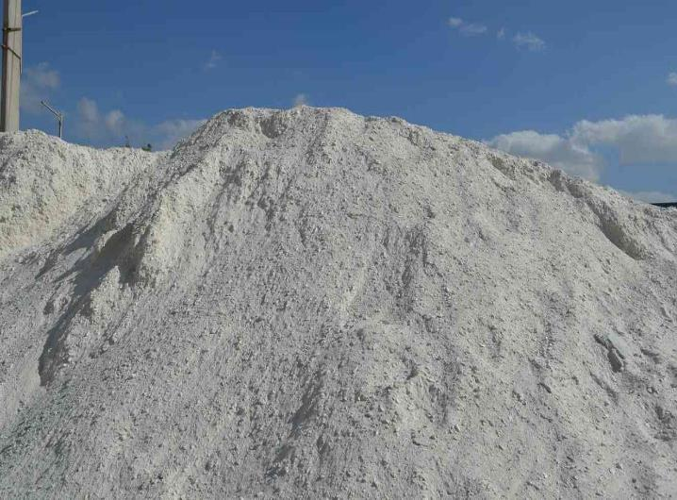
OUR FACTORY SITE

Slide 14
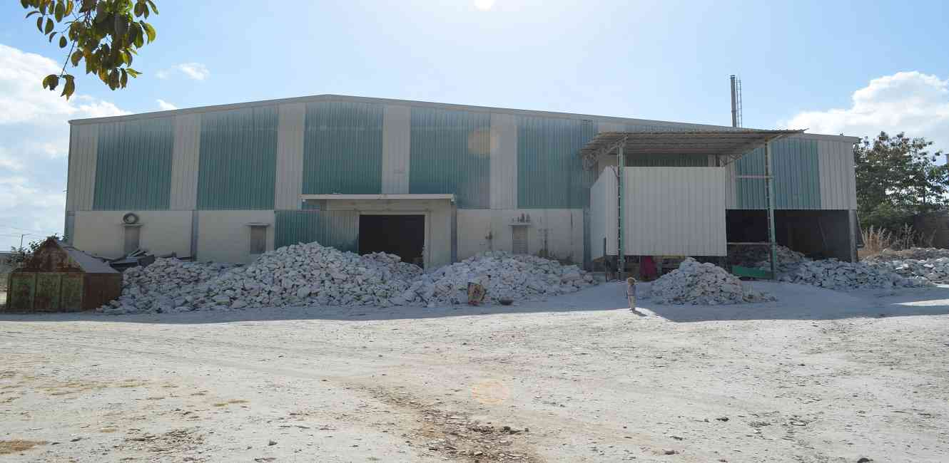
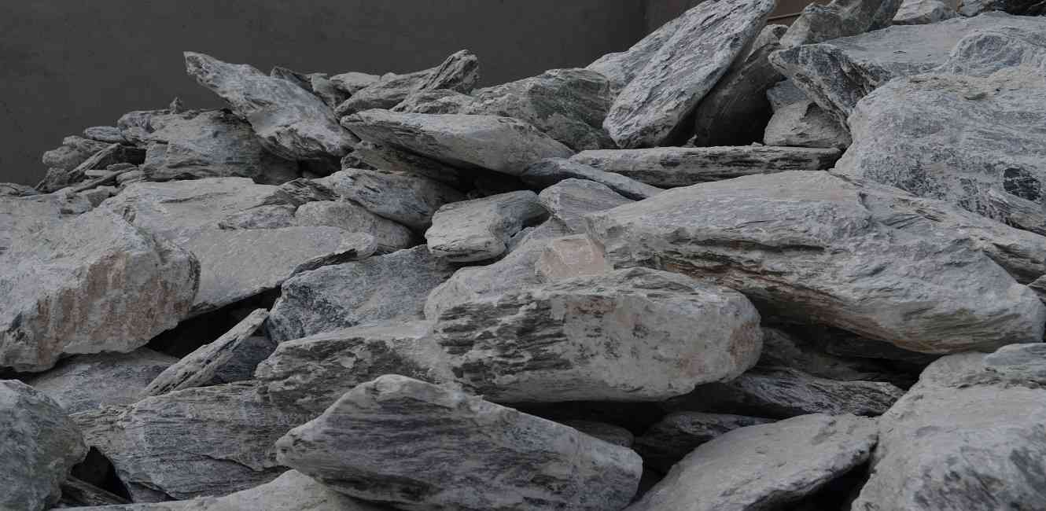
OUR FACTORY SITE

Slide 15
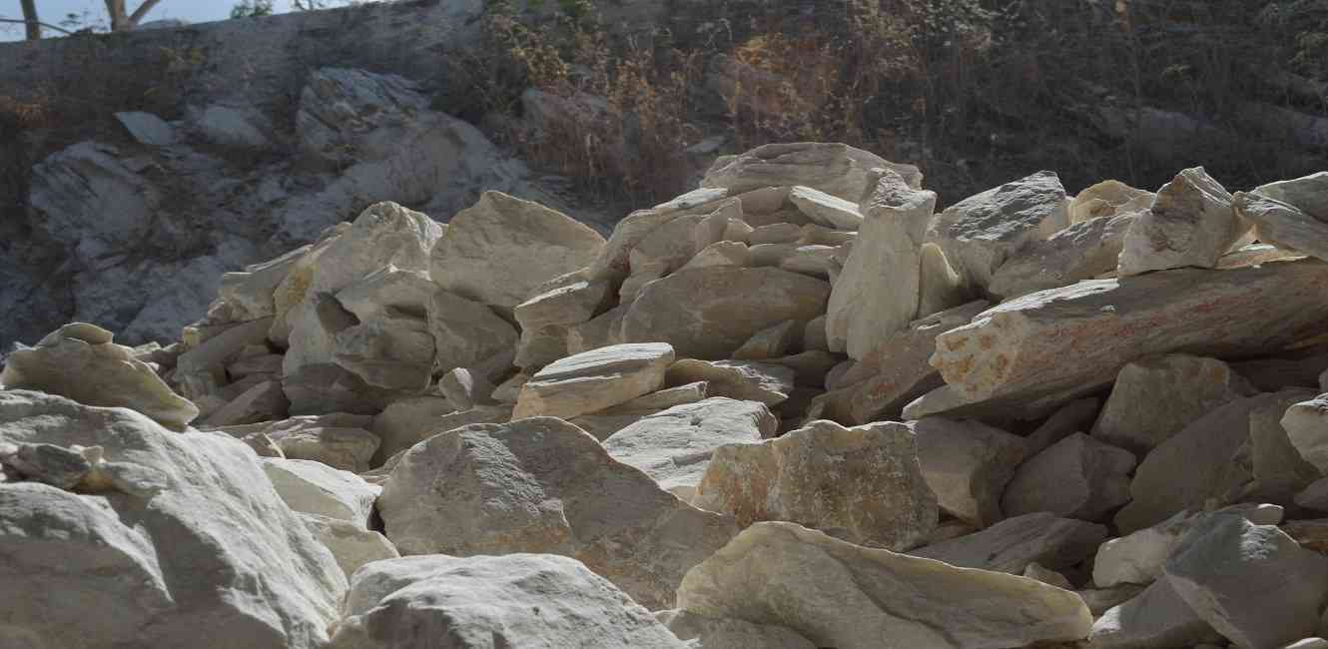
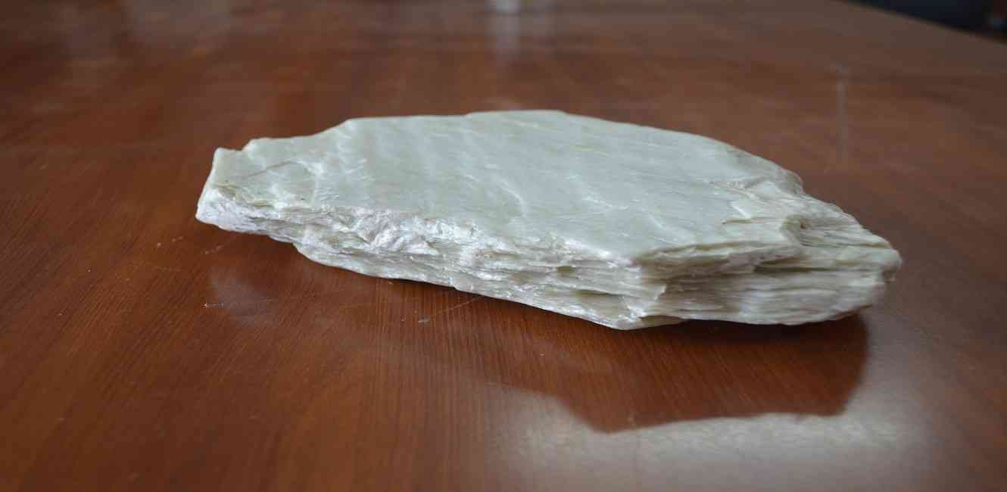
RAW MATERIALS

Slide 16
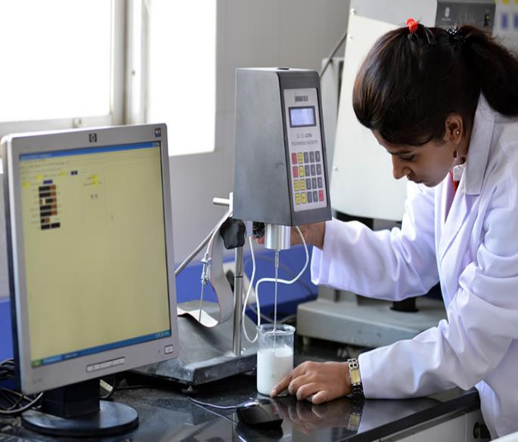
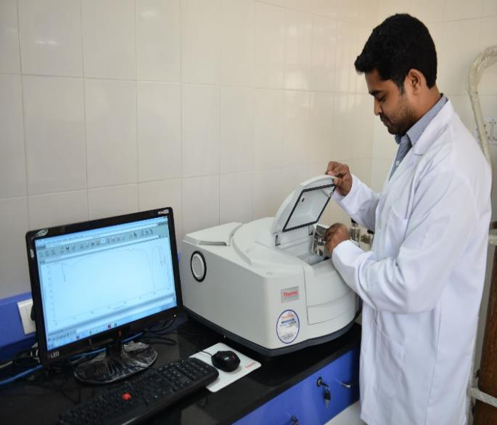
OUR LABORATORY

Slide 17
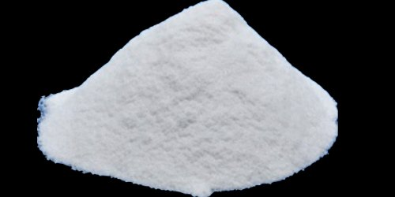
TALC POWDER/SOAPSTONE POWDER
Specific Gravity : 2.7 – 2.8 (low)
Mesh : 200 – 500n microns
Chemical formula :Mg3SiO10(OH)2
Other names : Steatite/French chalk/Talc
Structure: Lamellar/Platy/layered
Hardness (on Moh’s scale) : 1 (Softest mineral)
Bulk density(Tapped) gms/cc 0.45 – 0.5
Loss on ignition : 5.50%
Loss on drying : 0.05%
Ph balance : 8.5 – 9.5(Basic)
Matter insoluble in HCI : 95%(Min)
Refractive index : 1.540 – 1.590, Tolerance (+0.010/-0.002)
Grit percent by mass (max) : 0.02
Relative density : 2.7-2.9 (at 27 Deg C)
Water absorption(% by mass) : 0.1
Oil absorption ml/100gm : 28-35
Brightness : 78-98%

Slide 18
TALC POWDER/SOAPSTONE POWDER
PHYSICAL PROPERTIES:
Soft and very easy to carve
Non porous
Non absorbent
Low electrical conductivity
Heat resistant
High specific heat capacity
Resistant to alkalis
Absorb moisture, absorb oils, absorb oils, serve as a lubricant and produce an astringent effect with human skin

Slide 19
TALC POWDER/SOAPSTONE POWDER
GRADE | WHITENESS (in %) | Industry
GRADE – A | 90% to 95% | Pharmaceuticals and Cosmetics
GRADE - B | 85% to 90% | Superior grade paper, Textile, Ceramics
GRADE – C | 78% to 85% | Paper inferior grade, Paint, Rubber, Plastics and Detergent
GRADE - D | 78% and below | DDT

Slide 20
USES OF TALC POWDER
For Plastics:
Our talc is used as a filler in plastic industry due to its various useful purposes. The talc extracted here has a higher resistance to heat which reduces shrinkages in plastics by increasing its heat resistance. Also it provides stiffness to polypropylene, polyester, vinyl, etc.
For Paints:
Due to platy structure of talc extracted here it is quite helpful for paints. When the paint is applied and the water evaporates the mineral substances remain on the wall. Also the brightness level of talc extracted is high which is good for any kind of paint.
For Paper:
It is well known that the paper industry is a huge consumer of talc powder. But due to less abrasion levels in talc it is a much healthier option for paper industries.
For Rubber:
As the talc here has high resistance to heat and has good abrasion indexes it is preferred in rubber industries over the world.
For Ceramics:
A low iron content(<0.5%), heat resistance and other notable factors it is used in ceramics because after heating the possibility of black particles to be visible is lesser in talc here.
For Cosmetics:
Talc extracted here is bacteria free and poses no health hazards to skin. It is smooth, glossy and lusturous. It is fluffy when converted to powder form. Also impurities such as calcium and alumina are absent which makes it most suitable for cosmetics when applied on skin.

Slide 21
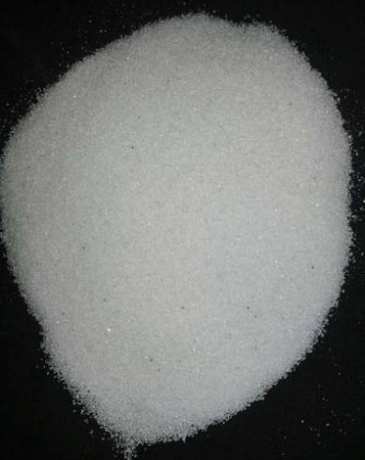
QUARTZ/QUATRZ SILICA
Chemical formula : SiO2
Colour : Pure form of this mineral is colour less, if impurities present then it is coloured
Structure : Sub angular, rhombohedral
Hardness on (on Moh’s scale) : 7
Specific gravity : 2.65
Bulk density(tapped) gms/cc : 165.5
Melting point : 2912 fahrehneit
Boiling point : 4000 fahrehneit
Ph balance : 7
Matter solubility in H2O : Insoluble
Refractive index : 1.544
Mesh : 250 mesh ( 65 micron) – 800 mesh (10 micron)
Average particle size(micron) : 3-11.3
Relative density : 130-430
Oil absorbtion ml/ 100 gm : 40
Brightness : 90-98 %

Slide 22
USES OF QUARTZ SILICA POWDER
In semi conductor industry, Silica powder is used to conduct reaction with hydrofluoric acid for engraving quartz.
Reaction of silica with lead oxide or sodium oxide is utilized to produce different grades of glass that includes borosilicate glass.
It is used as one of the key ingredients for micro chip in computer.
It acts as an additive for processing of plastics and rubber.
It is used as a powerful filler for producing construction material like concrete.
It is used for improving viscosity of coatings.
Useful for enhancing holding capacity of tire on wet surface.

Slide 23
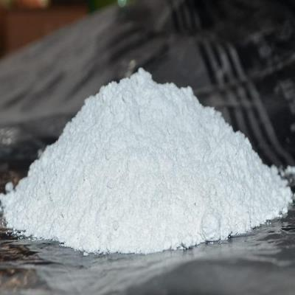
DOLOMITE POWDER
Chemical formula : CaMg(CO3)2
Colour : Colourless, white, green, grey, brown, black
Structure : Three directions of perfect cleavage
Hardness on (on Moh’s scale) : 3.5-4
Specific gravity : 2.8-2.9
Bulk density(tapped) gms/cc : 0.95-1.1
Ph balance : 9
Dispersibility : HG 5 – HG 4
Refractive index : 1.54
Mesh : 250 mesh ( 65 micron) – 800 mesh (10 micron)
Average particle size(micron) : 5.3-10.6
Relative density : 130-430
Oil absorbtion ml/ 100 gm : 20-18
Brightness : 90-96 %
Matter in HCI : Powdered from effervesces weakly in dilute HCI
CaCO3 : NIL- upto consumer requirement

Slide 24
USES OF DOLOMITE POWDER
RUBBER PRODUCTS:
A huge market for dolomite is rubber industry manufacturing different products as footwears, container, etc.
CONSTRUCTION:
In a crushed manner it is used extensively in construction industry such as base of roads, aggregate in cement and filling in different manners. Rail road Ballast also invites huge usage of dolomite sand.
AS A STRAINER:
Used in hydro power plants to strain all the impurities from water when used as sand formation.
THERMAL POWER PLANTS:
Due to its high resistance to heat it is used in kilns for lining in the inside part and also exterior.
CERAMIC INDUSTRY:
Due to its hardness and high gravity it is used hugely in tiles and other ceramic based industries , as well as a sintering agent in iron ore pelletization and as a flux agent in steel making.
CHEMICAL INDUSTRY:
Due to use of MgO in pharma and other scientific purposes, dolomite is used in this industry also. Extraction of MgO from powder or chips os done through chemical processing by treating it with various acids.

Slide 25
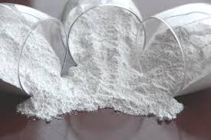
CALCITE POWDER
Chemical formula : CaCO3
Colour : White, Yellow, Red, Orange, BGreen, Grey, brown, black
Structure : Spherical and crystalline
Hardness on (on Moh’s scale) : 3
Specific gravity : 2.7102
Bulk density(tapped) gms/cc : 0.72 to 1.2 (as per particle size)
Ph balance : 9.4
Dispersibility : HG 4 – HG 7
Refractive index : 1.56
Mesh : 250 mesh ( 65 micron) – 800 mesh (10 micron)
Average particle size(micron) : 5.3-10.6
Relative density : 2.7102(2) g/cm3
Oil absorbtion ml/ 100 gm : 19-29( depending upon particle size)
Brightness : 90-98%

Slide 26
CALCITE POWDER
GRADE | WHITENESS (in %) | Industry
GRADE – A | 96% | Paints, Plastics, Coatings
GRADE - B | 94% | Paints, Paper, Plastics
GRADE - C | 92% | Paper, Rubber, Adhesive
GRADE - D | 90% | Cement and building material

Slide 27
USES OF CALCITE POWDER
PLASTICS:
Due to higher levels of brightness and best lustre the calcite extracted here is best suited for plastic industries and products as master batch/PVCP pipes/etc.
PAPER:
It’s a growing industry for calcium carbonate. These days soapstone and calcite are used simultaneously in paper industry. Lesser abrasion index makes it best suitable for paper.
PHARMACEUTICALS:
After proper treatments this material can be used for pharmaceuticals and food grade industry. Also huge intake in FMCG (edible)is there for this product.
CATTLEFEED AND PESTICIDES:
This product has a huge demand in this industry as it is a good carrying agent.

Slide 28
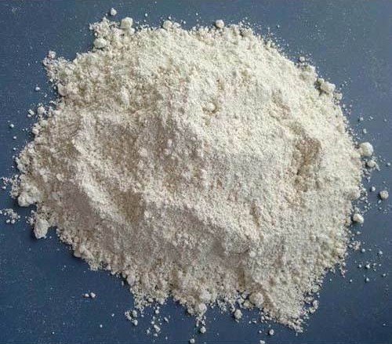
CHINA CLAY POWDER
Chemical formula : Al₂Si₂O₅(OH)₄
Colour : White or yellowish white, earthy mass or white powder
Structure : Dry powder, semi-dry noodle, or liquid slurry
Hardness on (on Moh’s scale) : 2-2.5
Specific gravity : 2.7-2.8
Bulk density(tapped) gms/cc : 0.65-0.75
Ph balance : 5.5-6.5
Refractive index : 1.565
Mesh : 300/400/500
Relative density : 1.8-2.6
Oil absorbtion ml/ 100 gm : 25-30
Brightness : 77-83%

Slide 29
CHINA CLAY POWDER
PHYSICAL PROPERTIES:
China clay is primary clay and generally found in white colour.
Casting rate : high casting rate in slip casting compared to ball clay
Particle size: large particles as compared to ball clay.
Green MOR: Modulus of rupture is low compared to ball clay
Plasticity: Low plasticity compared to ball clay
Refractoriness: High refractoriness

Slide 30
USES OF CHINA CLAY POWDER China clay used in all Kind of ceramic product production and other products for its properties. Following are the primary uses of the china clay :
China clay is used as a filter in paper and textile industry.
Used as a coating pigment
China clay is used in the manufacturing of porcelain, crockery and paint industry.
China clay is used in pharmaceutical and cosmetic industry.
It is used in varieties of papers, carboards and hardboards.
China clay must be free from silica and feldspar is used for electrical insulators.
China clay is used in soap , toothpaste, and cosmetic industry.

Slide 31


CONTACT DETAILS: Mr. KISHORE CHANDNI (CEO) - +91-982 12 77 629 Mr. UMESH KARTARI (Head Business Development) - +91-9819201633 Mr. ASHOK WADHWA (Director Technical) - +91-9819163180 ADDRESS: F-14, HI-LIFE MALL, 1st FLOOR, P.M.ROAD, SANTACRUZ WEST, MUMBAI 400054 MAHARASHTRA, INDIA email: info@sunriseexports.biz, snerasintl@gmail.com sunriseexports.biz Parent company : Sneras International (estd 1997 ) Mumbai, India

Slide 32

THANK YOU Registered Members – FIEO (Federation of Indian Exports Organisation), Govt. of India DGFT (Directorate General of Foreign Trade), Govt. of India

